Slide 1
An Improved DFA for Fast Regular Expression Matching
Author:
Domenico Ficara, Stefano Giordano, Gregorio Procissi, Fabio Vitucci, Gianni Antichi, Andrea Di Pietro
Publisher: 2008 ACM SIGCOMM
Presenter: Yuen-Shuo Li
Date: 2013/10/16

Slide 2
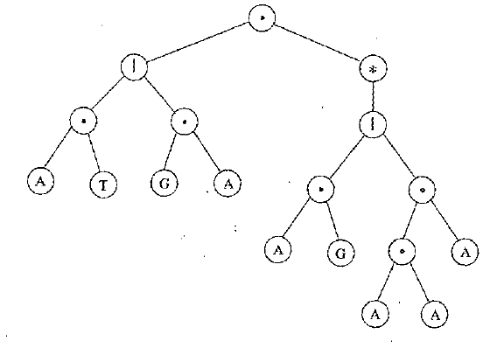
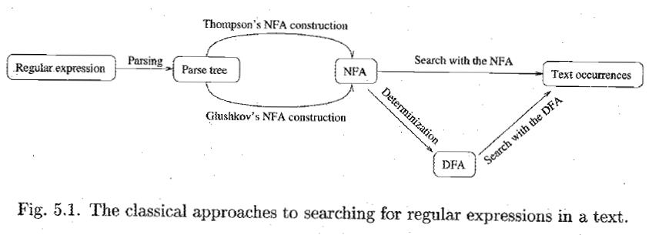
background
Notes:
NFA 的缺點是搜尋速度較慢，而 DFA的缺點是所需要記憶體較多
所以 DFA 的方法主要在嘗試減少 state 的個數或是 transition 的個數

Slide 3
introduction
This paper presents a new representation for deterministic finite automata, called Delta Finite Automata (FA), which considerably reduces states and transitions and requires a transition per character only, thus allowing fast matching.
Moreover, a new state encoding scheme is proposed and the comprehensive algorithm is tested for use in the packet classification area.
Notes:
這篇文章介紹了主要分兩個部分，一個是 delta-fa， 另一個是壓縮的技巧
Delta-fa 的主要目的在於減少 transition 的個數

Slide 4
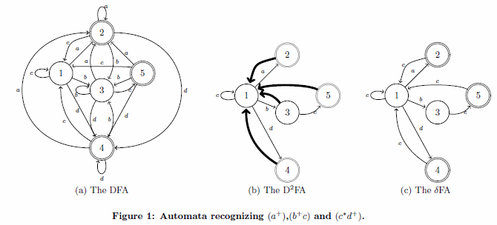
d²FA
To clarify the rationale behind δFA and the differences with D²FA, we analyze the same example brought by Kumar et al. in [14]:

Slide 5
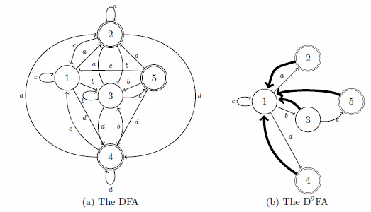
d²FA
The main idea in D²FA is to reduce the memory footprint of states by storing only a limited number of transitions for each state and a default transition to be taken for all input char for which a transition is not defined.
default transition
20 edges
9 edges

Slide 6
d²FA
When, for example, the D²FA is in state 3 and the input is d, the default transition to state 1 is taken. State 1 “knows" which state to go to upon input d, therefore we jump to state 4.

Slide 7
d²FA
However, it may happen that also after taking a default transition, the destination state for the input char is not specified and another default transition must be taken, and so on.
Notes:
如果 default transition 再不行，就會再 default transition 一次，一直重覆下去。

Slide 8
delta finite automaton
We introduce a δFA, D²FA-inspired automaton that preserves the advantage of D²FA and requires a single memory access per input char.
Notes:
Delta-FA 的概念是來自於 D2FA ，但好處是只需要傳一個給 State 即可。

Slide 9
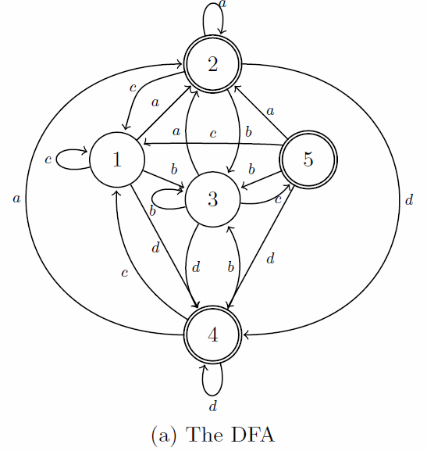
delta finite automaton
Observing the graph, it is evident that most transitions for a given input lead to the same state, regardless of the starting state
in particular, adjacent states share the majority of the next-hop states associated with the same input chars.
Notes:
觀察可以發現通常同一個 char 就會引導至同一個 state
甚至相連的 State 其 next-hop state 幾乎都是相同的

Slide 10
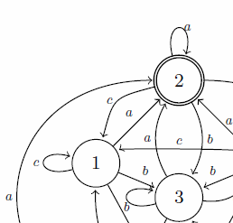
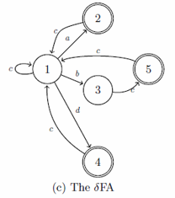
delta finite automaton
Then if we jump from state 1 to state 2 and we “remember" (in a local memory) the entire transition set of 1, we will already know all the transitions defined in 2 (because for each character they lead to the same set of states as 1).
This means that state 2 can be described with a very small amount of bits.
Notes:
也就是說只要記得上一個 state 的 transition set，就只要另外存不同的即可。
State 2 不用存 b，因為 State 1 有存。

Slide 11
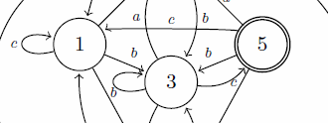
delta finite automaton
Instead, if we jump from state 1 to 3, and the next input char is c, the transition will not be the same as the one that c produces starting from 1; then state 3 will have to specify its transition for c.
Notes:
這裡的 State 3 之所以要存 c ，是因為和之前不同。

Slide 12
delta finite automaton
20 edges
9 edges
8 edges
δFA is to obtain a similar compression as D²FA without giving up the single state traversal per character of DFA.
Notes:
(不過我覺得 Delta-FA 的 transition 有點難算)

Slide 13
construction
The pseudo-code for creating a δFA from a N-states DFA (for a character set of C elements) is shown.
The algorithm works with the transition table t[s, c] of the input DFA. The final result is a “compressible" transition table t_{c}[s, c] that stores, for each state, the transitions required by the δFA only.
All the other cells of the t_{c}[s, c] matrix are filled with the special LOCAL_TX symbol and can be simply eliminated by using a bitmap.
Notes:
簡單來說，就是把 t[s, c] 壓縮成 t_{c}[s, c]
LOCAL_TX 代表空的

Slide 14
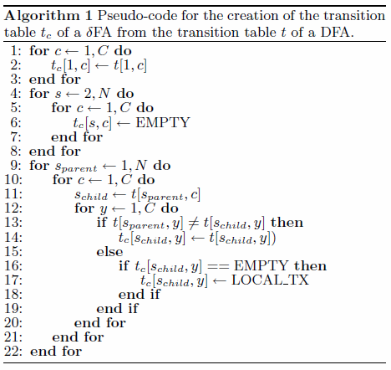
construction
Notes:
State 1 要全存
State 2 後先給空，再補上改變的 transition
(要保證每一個會到這個 State 的 transition 都是相同的，如果有不同，還是得存)

Slide 15
construction
After the construction procedure, since the number of transitions per state is significantly reduced, it may happen that some of the states have the same identical transition set.
If we find j identical states, we can simply store one of them, delete the other j-1 and substitute all the references to those with the single state we left.
Notice that this operation creates again the opportunity for a new state-number reduction, because the substitution of state references makes it more probable for two or more states to share the same transition set. Hence we iterate the process until the number of duplicate states found is 0.
Notes:
透過這個方法減少 transition 後，就可能會發現有些 state 的 transition set 完全相同，這樣一來，這相同 transition set 的 state 就可以合併成一個 state，進一步減少使用的記憶體。而這個過程可以一直重覆。

Slide 16
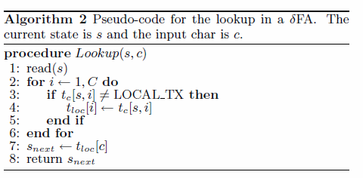
lookup
First, the current state must be read with its whole transition set(step 1).
Then it is used to update the local transition set t_{loc}: for each transition defined in the set read from the state, we update the corresponding entry in the local storage.
Finally the next state s_{next} is computed by simply observing the proper entry in the local storage t_{loc}.
Notes:
保證 transition set 每一個都是相同的，但是需要改才改

Slide 17
lookup
While the need to read the whole transition set may imply more than 1 memory access, we will show how to solve this issue by means of a compression technique we propose.
The lookup algorithm requires a maximum of C elementary operations (such as shifts and logic AND or popcounts), one for each entry to update.
However, in our experiments, the number of updates per state is around 10. Even if the actual processing delay strictly depends on many factors (such as clock speed and instruction set), in most cases, the computational delay is negligible with respect to the memory access latency.
Notes:
需要很多次 memory access 的問題後面解決
至於每次可能要進行 C 次運算，經過實驗後發現影響不大。

Slide 18
lookup
It is worth noticing that the “duplicate” definition of transitions for character c. We have to specify the c-transition for state 2 even if it is the same as the one defined in state 1, because state 2 can be reached also from state 3 which hasa different next state for c.

Slide 19
APPLICATION TO H-CFA AND XFA
One of the main advantage of our δFA is that it is orthogonal to many other schemes. Indeed, very recently, two major DFA compressed techniques have been proposed, namely H-cFA and XFA.
Notes:
這邊要強調的是 delta-FA 和其他方法通常不衝突，可以一起使用。

Slide 20
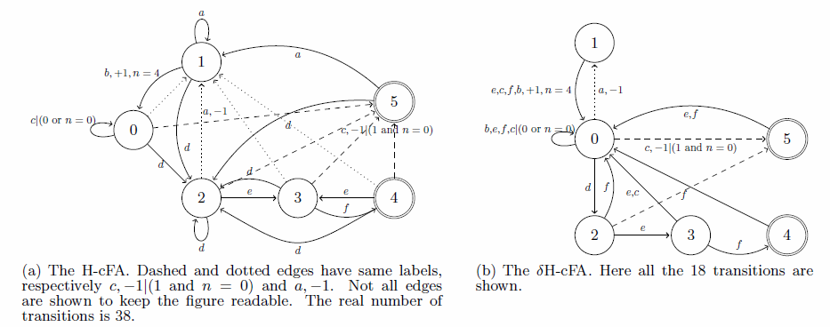
APPLICATION TO H-CFA AND XFA
For example, the aim is to recognize the regular expressions .*ab[^a]*c and .*def.
A DFA would need 20 states and a total of 120 transitions, the corresponding H-cFA uses 6 states and 38 transitions, while the δFA representation of the H-cFA requires only 18 transitions.
Notes:
似乎和減少 state 的方法比較不衝突

Slide 21
Compressing char-state pairs
In a δFA, the size of each state is not fixed because an arbitrary number of transitions can be present, and therefore state pointers are required, which generally are standard memory addresses.
They constitute a significant part of the memory occupation associated with the DFA data structure, so we propose here a compression technique which remarkably reduces the number of bits required for each pointer.

Slide 22
Compressing char-state pairs
Our algorithm (hereafter referred to as char-state compression or simply C-S) is based on a heuristic which is verified by several standard rule sets:
in most cases, the edges reaching a given state are labelled with the same character.
Notes:
其實就是依照 c分 group

Slide 23
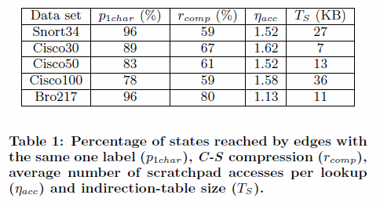
Compressing char-state pairs
For different available data sets the percentage of nodes which are reached only by transitions corresponding to a single character over the total number of nodes.

Slide 24
Compressing char-state pairs
As a consequence, a consistent number of states in the DFA can be associated with a single character and can be referred to by using a “relative" address.
All the states reached by a transition labelled with character c will be given a “relative" identifier (hereafter simply relative-id)
since the number of such states will be smaller than the number of total states, a relative-id will require a lower number of bits than an absolute address.
In addition, as the next state is selected on the basis of the next input char, only its relative-id has to be included in the state transition set, thus requiring less memory space.
Notes:
這裡只有文句說明，沒有詳細解釋，所以我只有用猜測的方式。
應該是用一個 label 對應多個會到的 state 的方式存，而不是一個 state 存多個 label 和會到的 state。

Slide 25
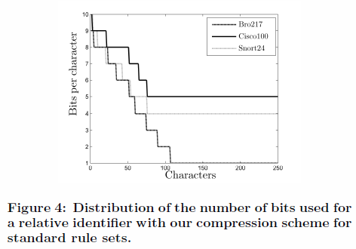
Compressing char-state pairs
In a D²FA, where a default transition accounts for several characters, we can simply store it as a relative-id with respect to the first character associated with it.
The absolute address of the next state will be retrieved by using a small indirection table.
Some states will be associated with several relative-ids and their absolute address will be reported more than once.

Slide 26
Indirection Table Compression
We present a lookup scheme which offers an adaptive trade-off between the average number of memory accesses and the overall memory occupation of the table.
The table that we use in our scheme encompasses two kinds of pointers: absolute pointers and local ones.
When a state has a unique relative-id, its absolute address is written in the table;
otherwise, if it has multiple relative-ids, for each one of them the table reports a pointer to a list of absolute addresses; such a pointer will require a consistently smaller number of bytes than the address itself.
Notes:
State 只要存 relative id 就好，不需要存 absolute address

Slide 27
C-S IN δFA
The C-S can be easily integrated within the δFA scheme and both algorithms can be cross-optimized.
C-S helps δFA by reducing the state size thus allowing the read of a whole transition set in a single memory access on average.
On the other hand, C-S can take advantage of the same heuristic of δFA: successive states often present the same set of transitions.
As a consequence, it is possible to parallelize the retrieval of the data structure corresponding to the next state and the translation of the relative address of the corresponding next-state in a sort of “speculative“ approach.
Notes:
Cs 減少 state size，所以可以減少 memory access

Slide 28
C-S IN δFA
As a consequence, when character c is processed, it is possible to parallelize two memory accesses:
retrieve the data structure corresponding to state s+1;
retrieve the absolute address corresponding to $A_{s+1}^{c}$ in the local indirection table.

Slide 29
Implementation
The implementation of δFA and C-S should be adapted to the particular architecture of the hardware platform. However, some general guidelines for an optimal deployment can be outlined.
In the following we will make some general assumptions on the system architecture; such assumptions are satisfied by many network processing devices (e.g. the Intel IXP Network Processors [12]).
Notes:
這個方法應該要採用特殊的硬體架構，但是基本還是可以談
硬體的架構很多，所以做一個假設

Slide 30
Implementation
In particular, we assume our system to be composed by:
a standard 32 bit processor provided with a fairly small local memory (let us suppose a few KBs)
an on-chip fast access memory block (which we will refer to as scratchpad) with higher storage capacity (in the order of 100 KB) and with an access time of a few dozens of clock cycles;
an off-chip large memory bank (which we will refer to as external memory) with a storage capacity of dozens of MBs and with an access time in the order of hundreds of clock cycles.

Slide 31
Implementation
We consider both δFA and Char-State compression algorithms. As for the former, two main kinds of data structures are needed: a unique local transition set and a set of data structures representing each state.
The local transition set is an array of 256 pointers(one per character) which refer to the external memory location of the data structure associated with the next state for that input char.
Notes:
我的猜測是 local transition set 存 state 的位置，透過 label 和相對位置紀錄
至於 state 本身存著一個 bitmap 和 pointer，bitmap 紀錄 pointer 有沒有效，pointer 指向對應的 next state(用 relative 的方法存)

Slide 32
Implementation
A δFA state is, stored as a variable-length structure. In its most general form, it is composed by a 256 bit-long bitmap (specifying which valid transition are already stored in the local transition set and which ones are instead stored within the state) and a list of the pointers for the specified transitions.

Slide 33
Implementation
If the number of specified transitions within a state is small enough, the use of a fixed size bitmap is not optimal:
in these cases, it is possible to use a more compact structure, composed by a plain list of character-pointer couples.
Note that this solution allows for memory saving when less than 32 transitions have to be updated in the local table.
Notes:
如果 valid transition 很少，可以直接用 bitmap 存
256 / 32 = 8

Slide 34
EXPERIMENTAL RESULTS
We show a performance comparison among our algorithm and the original DFA, D2FA and BEC-CRO. The experimental evaluation has been performed on some data sets of the Snort and Bro intrusion detection systems and Cisco security appliances [26].
In details, such data sets, presenting up to hundreds of regular expressions, have been randomly reduced in order to obtain a reasonable amount of memory for DFAs and to observe different statistical properties.

Slide 35
EXPERIMENTAL RESULTS
The compression in tab.3.a is simply expressed as the ratio between the number of deleted transitions and the original ones
Notes:
% Regex wildcards 包含 wildcard 的 rule
D2FA 用的是 regex-tool[18]

Slide 36
EXPERIMENTAL RESULTS
while in tab.3.b it is expressed considering the overall memory saving, therefore taking into account the different state sizes and the additional structures as well.

Slide 37
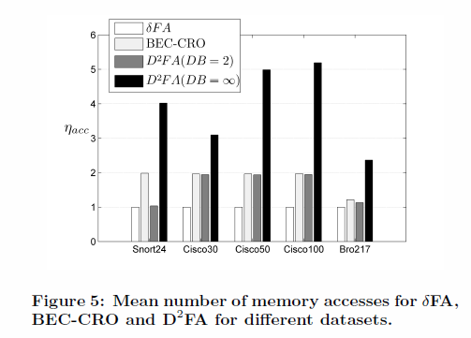
EXPERIMENTAL RESULTS

Slide 38
PACKET CLASSIFICATION WITH δFA
Our proposal is to use δFA to represent classification rule sets. While such rules generally specify single bits of the header, we need byte-wise rules to define regular expression; therefore rules are “exploded" to 8-bits boundaries.
Each rule (dened by the usual 5-tuple SrcIP, DestIP, SrcPort, DestPort, and L4 Protocol) has then to be translated into a regular expression and an equivalent DFA has to be built.
Each byte belonging to header fields composing the 5-tuples is taken in the DFA as a character.

Slide 39
PACKET CLASSIFICATION WITH δFA

